Slide 1
Adapting optimization models to better inform realistic energy decisions
Kate Anderson
Advanced Energy Systems
Thesis Proposal Defense
September 22, 2020
Notes:
Good morning everyone, thanks for joining this morning to review my thesis proposal on how optimization models can be adapted to better inform realistic energy decisions.

Slide 2
Agenda
Current research
Optimizing energy systems
Developing diverse solutions
Integrating value of resilience
Investigating the gap between modeling and deployment
Proposed submissions and timeline
Acknowledgments
Notes:
I’ll plan to go over the current status of my research in these four areas, and then talk about proposed journal article submissions and timeline.

Slide 3
Motivation
Increasing Model Transparency
Providing Multiple Options
Integrating Qualitative Values
Modifying Tool Use and Communication
A gap exists between actual and modeled optimal clean energy deployment.
Qualitative values and practical deployment barriers are not always captured in models.
This can lead decision makers down paths that will ultimately fail.
This research explores how models can be adapted to inform more realistic energy solutions.
Notes:
The motivation for this research stems from my experience over many years of using optimization models to guide client energy decisions towards economic, sustainable, and resilient energy choices. I have worked with a wide range of partners from federal agencies to commercial companies, universities, cities, and tribes.
A common theme across all of these diverse groups is that they don’t do what is economically optimal. Despite the fact that my model shows the most economic path to achieve their goals, they often don’t follow that path.
If you ask them why, there are good reasons. Maybe they can’t secure the upfront capital required. Maybe their building is leased, and the contracting process to install PV on the roof is too complex. Maybe they can’t get their battery insured because insurers are nervous about it catching on fire. There are many practical reasons—but these factors are often not captured in models.
This trend is not unique to my experience. Universally, across energy models at many scales and in many countries, studies that find a gap between modeling results and deployment. A recent retrospective review of 25 years of energy futures modeling in the United Kingdom found real world developments were entirely outside the range of scenarios the models predicted.
Why does this matter? Well, at a local scale, a model that doesn’t capture key decision drivers might cause someone to spend significant time and resources on a project that will ultimately fail. At a larger scale, unrealistic models could lead to poor legislative or policy decisions that result in falling short of climate targets.
Therefore, this research focuses on understanding key drivers and uncertainties of energy deployment, and how these can be integrated into models to better guide decision makers toward realistic, implementable clean energy solutions, and ultimately, toward clean energy deployment at scale.
The graphic on the right shows the different methods I explore for adapting energy models to better inform decisions. First, we introduce the REopt model, and to increase transparency we present the mathematical formulation and case studies that highlight its unique capabilities. Second, we explore techniques for providing multiple solutions for decision makers to choose from. Third, we look at integrating value streams that are not typically quantified (like resilience). And finally, we consider options to modify the way the tool is used and results are communicated to increase clean energy implementation.

Slide 4
Optimizing design and dispatch of a renewable energy system
Increasing Model Transparency
Providing Multiple Options
Integrating Qualitative Values
Modifying Tool Use and Communication
Oluwaseun Ogunmodede, Kate Anderson, Dylan Cutler, Dr. Alexandra Newman
Notes:
We’ll start with the first topic in the upper left corner, increasing model transparency.
This research presents REopt, a model for optimizing the design and dispatch of behind the meter distributed energy systems.

Slide 5

Problem Overview
The Nation’s Energy Supply Is in the Midst of a Transformation
As costs decrease, renewable energy (RE) deployment is growing worldwide.
Generation is increasingly distributed, with 31% of new capacity behind-the-meter.
With increasingly integrated and complex systems, back-of-the envelope calculations are no longer sufficient to determine distributed energy project potential.
Notes:
Before we dive into the details of the model, I’d like to start with why I’m focusing on distributed energy systems for this research.
A lot of energy systems optimization research focuses on energy deployment by utilities at national scales.
However, the energy system is undergoing a transformation right now, with generation becoming increasingly distributed. 31% of new capacity today is installed behind-the-meter, at the customer’s site, rather than at a central utility plant.
This is introducing a lot of new complexities in the energy system, as well as opportunities, and so its an interesting area for research.

Slide 6
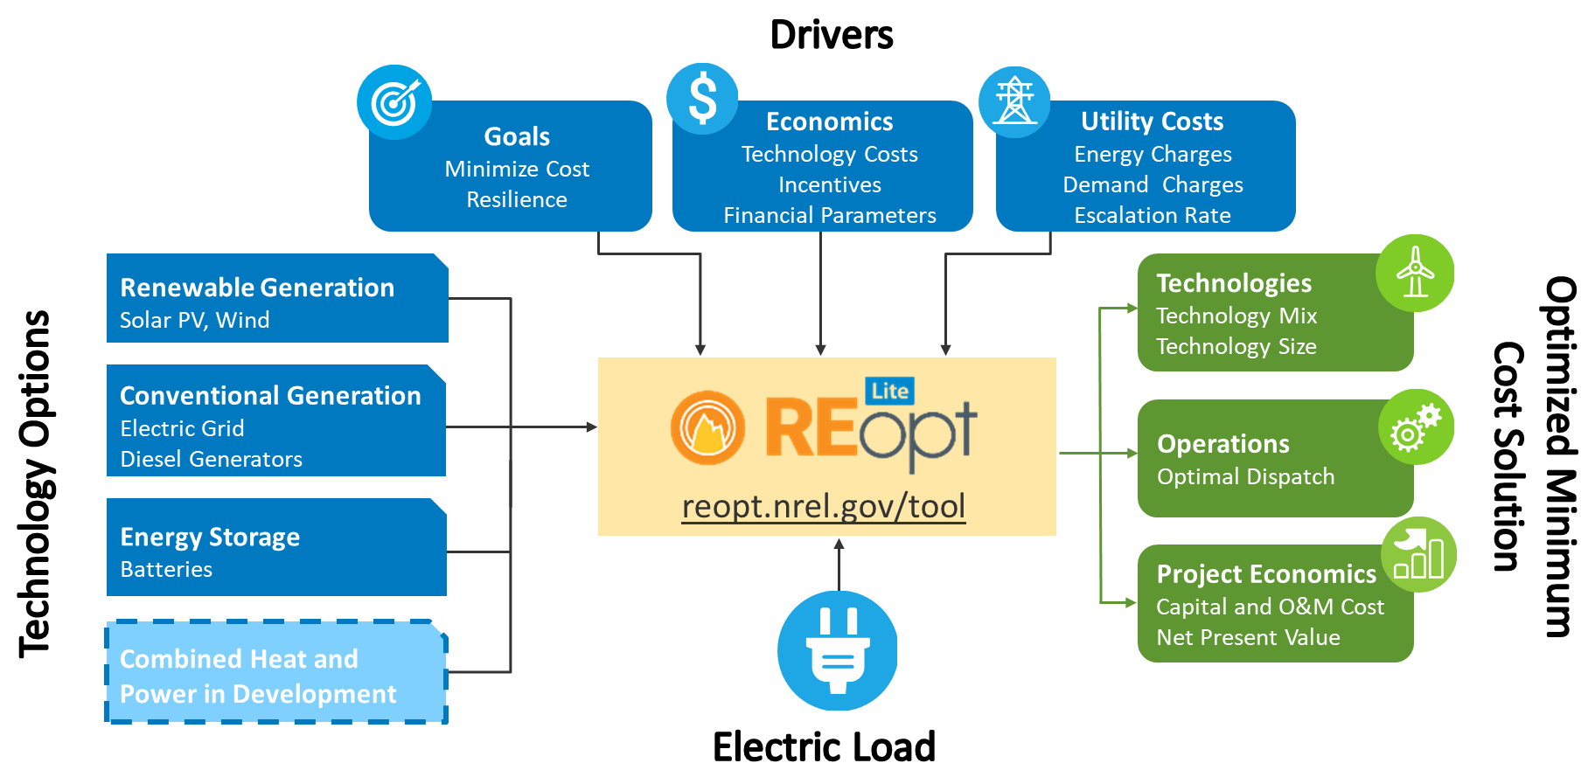
Renewable Energy Optimization (REopt)
Formulated as a mixed integer linear program, REopt Lite provides an integrated cost-optimal energy solution.
Notes:
The model we use for this research is called REopt, which stands for renewable energy optimization.
It is formulated as a Mixed Integer Linear Program
Mathematical model written in the Julia JuMP programming language, and can be solved using various solvers including Xpress and CPLEX
Solves energy balance at every time step for entire year (typically 15-minute or hourly intervals)
At each time step, the load must be met from some combination of grid purchases, on-site generation, or discharge from storage
The model finds the optimal technology sizes and dispatch strategy subject to resource, operating, and goal constraints, with the objective of minimizing life-cycle cost of energy
Resulting life cycle cost is guaranteed optimal to within a known gap subject to modeling assumptions
Some key limitations of the model are that it:
Does not consider power flow or transient effects
Has perfect prediction of upcoming weather and load
Assumes all years in analysis horizon are the same (typically 25 years)

Slide 7
Literature Review
Techno-economic distributed energy tools are primarily simulation-based.
Many optimization techniques in the literature are implemented only in research models.
REopt Lite is unique because it provides an integrated, optimized solution with transparency and ease of use.
Optimization | Integration | Ease of Use | Open Source
RETScreen
TRNSYS
SAM
DER-CAM
HOMER
iHOGA
REopt
Notes:
In our review of the literature, we found four main things that set this model apart.
First, while there are many optimization techniques implemented in research models, publicly available techno-economic distributed energy tools are primarily simulation-based. These include models like RETScreen, SAM, and HOMER. These are highly capable and widely used models, but they do require a user to know the system size they want to evaluate.
Second, a couple of the most common tools do not consider the integration of multiple technologies, but rather evaluate them one at a time. Integration is increasingly important as many distributed energy technologies are synergistic and deployed together as hybrid systems.
Third, those that do include both optimization and integration tend to be limited to only expert users, significantly limiting their reach and impact.
And finally, most of these models are proprietary, black-box models which limits the flexibility, transparency, and opportunity for impact.
Therefore, the unique contribution of the REopt Lite model is that it provides all four of these things– optimization to help users identify system sizes and dispatch strategies to minimize cost; integration of multiple technologies; ease of use; and open source code for transparency and flexibility.

Slide 8
Mathematical Optimization for Energy Design
Mathematical optimization provides numerous benefits for energy design and dispatch:
Well-structured problem definition
Guaranteed global optimality (to within some known bound)
No need for the user to pre-select technology size or dispatch
However, large-scale, comprehensive design and dispatch optimization models are not typically made available to the public due to:
Complex model formulations
Long solve times
This work presents a detailed mathematical formulation of a complex design and dispatch model to enable broad use.
Notes:
So, why do we use a mathematical optimization model when many other tools rely on simulation?
Mathematical optimization provides 3 main benefits.
First it provides a well-structured problem definition.
Second, it guarantees global optimality to within some known bound
And finally, there is no need for the user to pre-select technology size or dispatch. This is really important, especially as the energy system is changing and former rules of thumb for sizing may no longer apply.
However, there are some hurdles to making this kind of large scale design and dispatch model available for broad use. The reason many optimization models remain research models, and not public tools, is that accurately modeling these systems requires complex model formulations, and often have long solve times.
In this work we try to take advantage of the benefits optimization provides, while maintaining reasonable solve times.

Slide 9
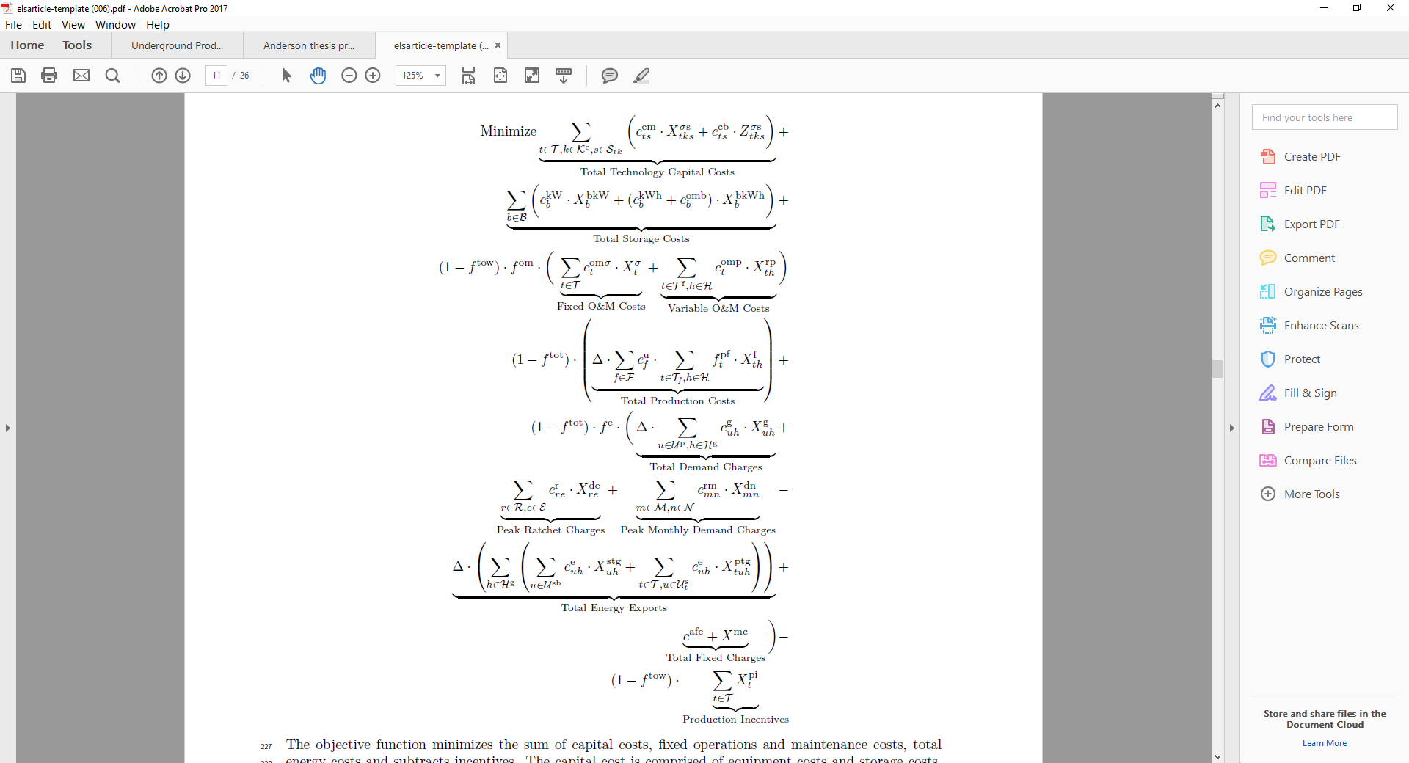
REopt Lite Objective Function
The objective function minimizes the lifecycle cost of energy, including capital costs, operation and maintenance costs, energy costs, and incentives.
Notes:
Here we show the objective function of the REopt lite model.
The objective is to minimize lifecycle cost of energy, including capital costs and operation and maintenance costs (shown on the first line), energy costs made up of production and demand charges (shown on the second line), and energy exports, fixed charges, and production incentives (shown on the third line).

Slide 10
REopt Lite Constraints
Fuel constraints
Switch constraints
Storage size, state of charge, and operational constraints
Production incentive cap
Power rating
Load balancing and grid sales
Rate tariff constraints
Minimum utility charge
Non-negativity and integrality
Notes:
We minimize lifecycle cost of energy with several constraints in mind.
Fuel constraints restrict fuel consumption to the amount of fuel available; these are typically applied to on-site backup diesel generators with fixed on-site fuel storage.
Switch constraints restrict the rate of production from a technology to an operating window between the system’s minimum turn down and its maximum size. For example, in the diesel generator, to avoid wet stacking the generator has to operate above some minimum load, but at no greater than its rated capacity.
Storage constraints ensure that the stored energy does not exceed the battery energy capacity, the charge and discharge in each timestep does not exceed the power capacity, and they provide inventory balance for the state of charge
Production incentive constraints calculate total production incentives available for each technology, and set an upper bound on the size of system that qualifies for production incentives.
Power rating constraints impose lower and upper limits on the power rating of a technology, and ensure only selected technologies and subdivisions in a technology class are nonzero.
Load balancing and grid sales constraints account for all generation, from renewable energy, storage, and the grid, and ensure that it is equal to demand from site load, battery charging, and energy exports across all time steps.
Rate tariff constraints enforce net metering limits, the order of pricing tiers in utility rate tariffs, and demand ratchets.
Minimum utility charge constraints enforce a minimum payment to the utility provider
Non-negativity and integrality constraints ensure all variables assume non-negative values and establish integrality of appropriate variables.

Slide 11
Case Studies
We demonstrate case studies that highlight the impact of REopt’s unique integration and optimization features on technology size and economics:
Optimization of system size
Integration of multiple technologies
Modeling complex utility rate tariffs
Modeling incentives
Notes:
Now we’ll take a look at why these complexities matter, and what the benefit of including them in the model is. In the paper we focus on 4 case studies, demonstrating the impact of size optimization, technology integration, and rate tariff and incentive modeling. Today I’ll walk through the first two.

Slide 12
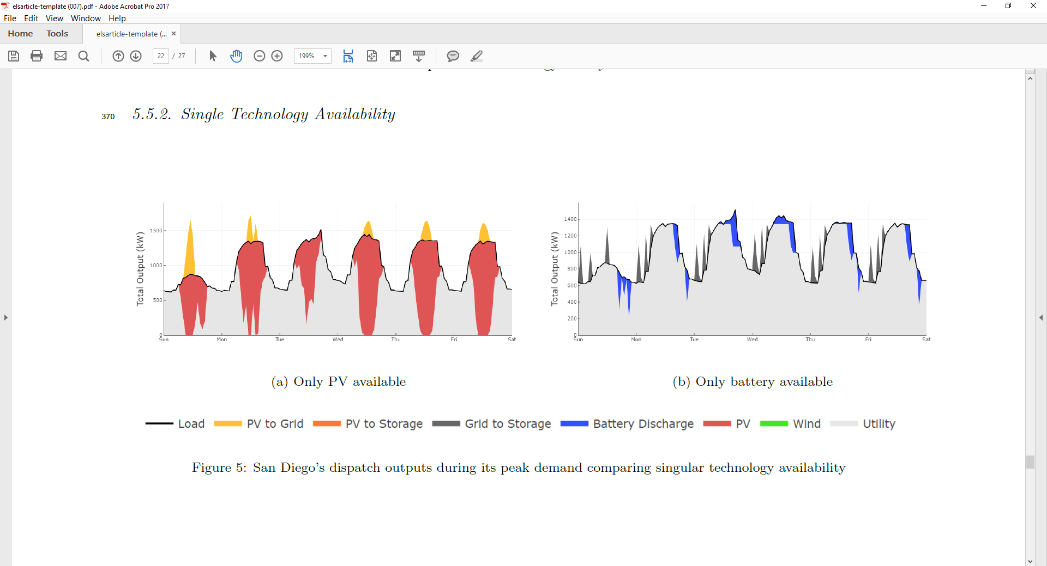
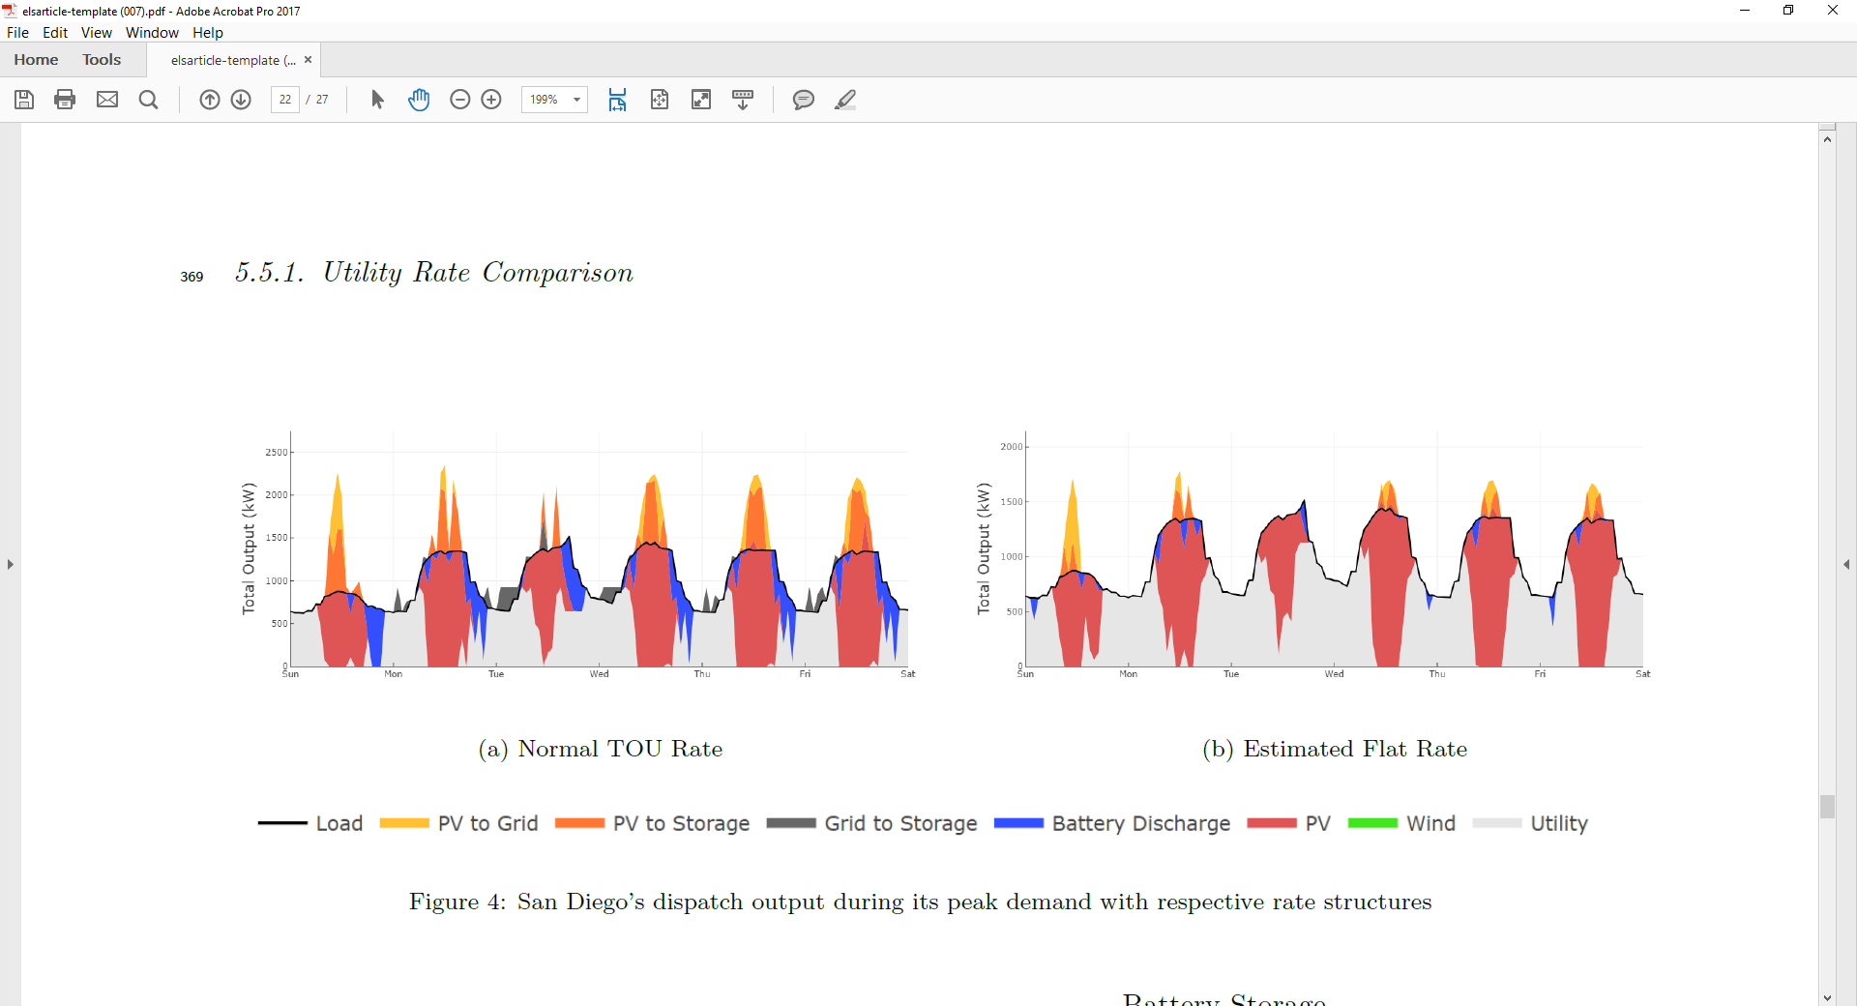
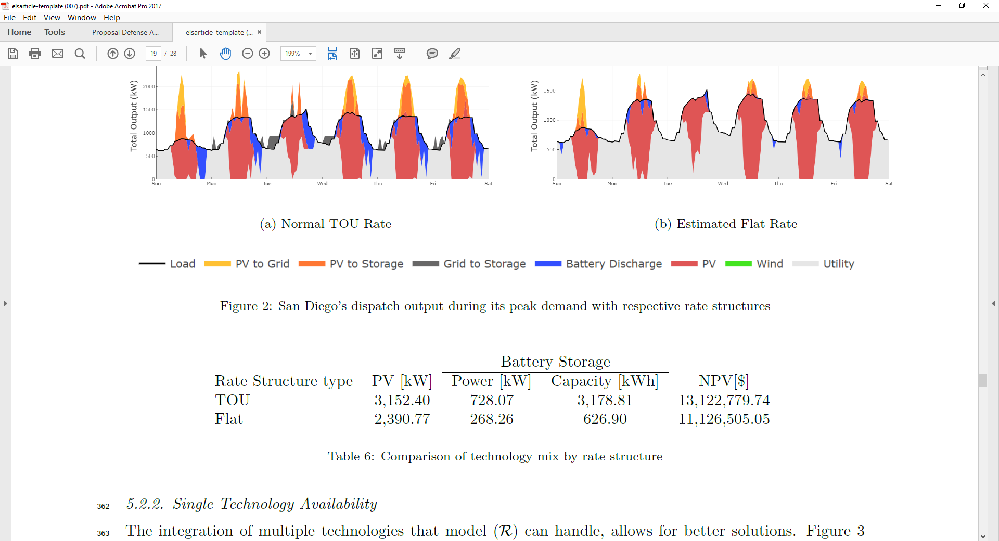
Example Results: Integration
PV Only
Some distributed energy techno-economic decision models do not model integration of technologies.
This case study shows the impact of integration on optimum system size and net present value of the investment.
Battery Only
System | Size | NPV
PV Only | 2309 kW | $1,376,969
Battery Only | 449 kW; 1485 kWh | $361,433
Integrated PV + Battery | PV: 3152 kW Battery: 728 kW; 3179 kWh | $2,703,000
Integrated PV + Battery
Notes:
2,511,451
As mentioned earlier, some of the most widely used distributed energy decision tools evaluate technologies one at a time, as if there is no interaction between them.
The problem with this is that these technologies are often synergistic, and the benefit of the two together is greater than each individual one.
For this case study, we use a site in San Diego, where both PV and battery are economical.
If we were to size PV alone, the optimum size that minimizes lifecycle cost of energy to the site is 2,309 kW.
If we were to size battery alone, the optimum size is a 449 kW, 1485 kWh battery.
These systems, however, would be missing out on even greater savings available if the analysis had considered the interaction of the two technologies.
In the top right graphic, we can see that PV offsets a lot of energy use, but on its own is not very effective in reducing peak demand. We can see this on the third day shown in this graph, where peak occurs just as PV generation is tailing off for the day, and PV only provides a reduction of about 100 kW.
In the second graphic in the middle, we see a battery alone is a little better at driving down demand, especially in the most expensive late afternoon/early evening hours, where demand is reduced from about 1500 kW to 1100 kW on that third day. But, the battery does not provide any energy savings.
In the third graphic on the bottom, we see that when PV and battery are integrated, they work together to both significantly offset energy purchases and reduce peak demand from 1500 kW to around 900 kW in the daytime, and as low as 700 kW during peak price evening hours.
A battery alone could have done this, but it would require a much larger battery, and the capital cost would have been prohibitively expensive. A PV system alone could not do this because it does not generate during the peak price times. Therefore, it is the combination of the two that are most powerful, and offer twice as much savings as the PV alone.

Slide 13
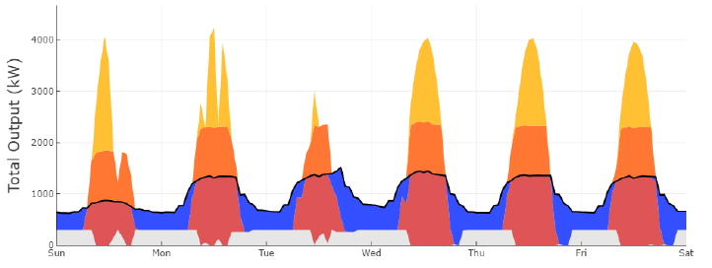
Example Results: Optimization
Some distributed energy techno-economic decision models do not optimize size of technologies. Users must input size, often based on rules of thumb.
This case study shows the impact of optimization on system size and net present value of the investment.
Sized to meet 100% of annual energy consumption
Sizing Method | Size | NPV
Meet 100% of annual energy consumption | PV: 5,681 kW Battery: 970 kW; 29,104 kWh | -$4,912,083
Minimize lifecycle cost of energy | PV: 3,152 kW Battery: 728 kW; 3,179 kWh | $2,703,000
Sized to minimize lifecycle cost
Notes:
In the next case study, we look at the impact of optimizing system size
Many of the most widely used distributed energy decision tools are based on simulation rather than optimization. This means that the user has to input the system size, typically based on rules of thumb.
Here we compare optimized system sizes to common rules of thumb, where we size the PV system to meet 100% of annual energy consumption, and the battery to cover 1 day of average load, in case of cloudy weather or a grid outage.
We can see from the table at the bottom that sizing systems based on these rules of thumb results in much larger systems that have a negative net present value.
When system sizes can be optimized, however, we see significant economic savings from smaller systems.
Now, in a simulation tool, the user could have run through many sizes and may have eventually landed on something equal to or near the optimal, but it would take a lot of time and computational resources, particularly for a problem like this where we’re modeling multiple technologies.
So, here we see that optimization provides a method to quickly identify economic distributed energy sizes. This is likely to become more important as hybrid DER systems composed of multiple technologies become more common.

Slide 14
Future Work
Complete case studies
Submit paper to Applied Energy

Slide 15
Developing diverse solutions to inform energy decisions
Increasing Model Transparency
Providing Multiple Options
Integrating Qualitative Values
Modifying Tool Use and Communication
Kate Anderson, Dr. Alexandra Newman, Dr. Adam Warren
Notes:
Now we’ll transition to the second method I’m exploring for adapting energy models to better inform decisions.
This works looks at techniques for providing multiple solutions for decision makers to choose from.

Slide 16
Uncertainty in Energy Models
Accounting for uncertainty is a major challenge of optimization models.
Parametric uncertainty arises from lack of knowledge about model inputs.
Structural uncertainty results from inability to model certain factors.
Uncertainty
Uncertainty
Parametric
Sensitivity Analysis
Structural
Modeling to Generate Alternatives
Monte Carlo Simulation
Stochastic Programming
Robust Optimization
Notes:
The idea behind this is that models focus on quantitative aspects of decision-making that lend themselves to modeling, but often do not account for more qualitative drivers of deployment, which can lead to a lot of uncertainty in modeling results
In my literature review, I found that assessing uncertainty is one of the major challenges and shortcomings identified in optimization models
The literature generally divides uncertainties into two categories: parametric and structural
Parametric uncertainties come from lack of knowledge about model input values like load or future energy prices. For example, most models assume a utility cost escalation rate that defines how utility costs will escalate over the lifetime of the project—often 25 years. But its difficult to predict how these costs are actually going to change. This is a major source of parametric uncertainty.
Structural uncertainty, on the other hand, comes from inability to model certain factors. This can include the role that non-economic factors, politics, social norms, and culture play in decisions.
Parametric uncertainty is often addressed through techniques like sensitivity analysis, Monte Carlo simulation, stochastic programming, and robust optimization techniques. These techniques are well covered in the literature, where I found over one hundred papers that describe the use of these techniques in energy models.
Structural uncertainty is less explored in the literature, and I only found a few papers that described some early research on addressing structural uncertainty in energy models through modeling to generate alternatives. For my research, I plan to concentrate on this less explored topic of structural uncertainty.

Slide 17
Modeling to Generate Alternatives
We formulate this problem as a mathematical optimization model with an objective function, variables, and constraints that provide a single optimal solution.
We then search the solution space for alternate, near-optimal solutions.
Multiple good-quality solutions allow the decision maker to select the best solution for the real-life problem, considering criteria that could not be expressed in the model.
Notes:
For this research, we again use REopt, which as you saw earlier is formulated as a deterministic mixed integer linear program, with an objective function, variables, and constraints that provide a single optimal solution.
This is a common formulation for large, dynamic problems that contain discrete decisions. We choose this format because of the rich solutions we can generate.
However, we then adapt it to generate multiple solutions by searching the solution space for additional, near-optimal solutions. This technique is called modeling to generate alternatives.
The thought behind this is that providing multiple good quality solutions allows the decision maker to select the best solution for the real-life problem, considering criteria that could not be expressed in the model.

Slide 18
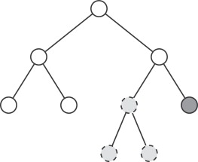
Method #1: Branch-and-Bound Tree
Integer programs are solved through branch-and-bound trees, which eliminate sub-optimal branches for efficiency.
We explore alternate solutions by retaining feasible, but near-optimal, solutions.
The user defines the number of solutions, the maximum gap between alternate solutions and the optimal, and the diversity of solutions.
Optimal
Near-optimal
Notes:
So, we approach this problem using three different methods, the first of which is shown here.
Mathematical optimization models like this one are solved through branch and bound trees.
These trees start by enumerating solutions, but rather than exploring every solution which could be quite time consuming, we eliminate sub-optimal branches along the way to increase efficiency.
Sub-optimal solutions are typically pruned, or discarded, and that part of the tree is not explored any further. This speeds up the search.
However, in this case, we store some of these alternate solutions. Even though they may be worse than the optimal, if they are close, we may still want to consider them.
Using the solver’s solution pool feature, we can define parameters around the desired number of solutions, the maximum gap between alternate solutions and the optimal, and the diversity of solutions.
One key limitation of this method is that the solutions are distinguished by the values of discrete variables only. This is because there is an infinite number of possible values for continuous variables and they cannot all be enumerated. So, for models like ours where key decision variables are continuous, this can be limiting.

Slide 19
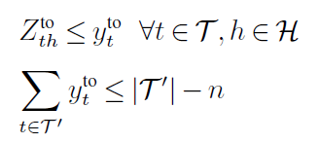
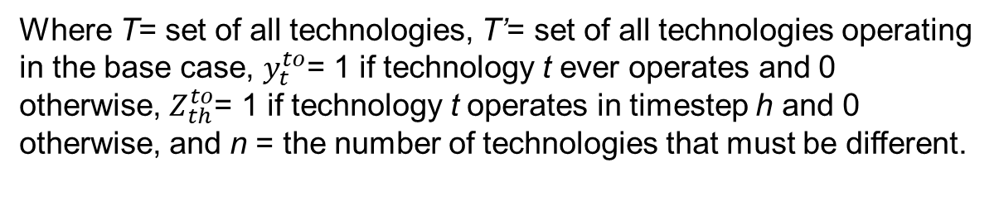
Method #2: Integer-Cut Constraints
Initialization: k=0
We iteratively solve the optimization model, each time adding a constraint to exclude the previous solution.
Model
(k integer-cuts)
Optimization
Ensures binary is 1 if the technology operates in any hour
Sums over all technologies that operate in the optimal solution and requires the alternate solution to be different from the optimal by at least n technologies
k=k+1
(k+1) solution
Integer-cut
Termination criteria met?
no
Where T= set of all technologies, T’= set of all technologies operating in the base case, $y_{t}^{to}$= 1 if technology t ever operates and 0 otherwise, $Z_{th}^{to}$= 1 if technology t operates in timestep h and 0 otherwise, and n = the number of technologies that must be different.
yes
Evaluate solutions
Notes:
In the second method, we use integer cut constraints to generate alternate solutions.
In this method, we iteratively solve the optimization model, as shown in the diagram on the left, and each time we add a constraint that precludes the previous solution. This forces the model to find a new, alternate solution.
This slide shows the two constraints we add to do this. The first constraint determines whether a technology ever operates in the solution, and sets y to 1 if it does. This variable is essentially accounting for whether a technology is part of the solution or not
The second constraint sums over all those y’s, and says that the alternate solution has to be different from the optimal by at least n technologies. In our case, we set n to 1. So if our optimal solution includes PV, wind, and storage, the alternate can include 2 of those technologies but not all 3.
This method provides diversity in which technologies are included in the solution.

Slide 20
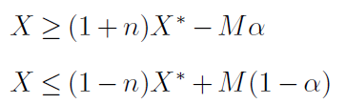
Method #3: Continuous Constraints
Initialization: k=0
Model
(k continuous constraints)
We iteratively solve the optimization model, each time adding a constraint to restrict the size of technologies to be at least some percent different from the sizes given in previous solutions.
Optimization
k=k+1
Continuous constraint
Restrict the size of technologies to be some percentage greater than or less than their size in the previous solution
(k+1) solution
Termination criteria met?
no
Where X= size of technology, X*= size of technology in the previous case, n= decimal percent difference, M= a big number, and α= variable that enforces binary logic (1 if some fraction of technology X* is greater than or equal to X and 0 otherwise).
yes
Evaluate solutions
Notes:
Finally, in the third method we use continuous constraints.
This is like the previous method, but rather than restricting which technologies are in the alternate solution, we restrict their size. So, the alternate solution can have the same technologies, but the size needs to be at least some percent different than the previous solution. In our example, we use 50%, so if the first solution sizes PV at 100 kW, the next solution must size PV less than 50 kW or greater than 150 kW.
This method provides diversity in the size of technologies.

Slide 21
Case Study Data & Assumptions
Input | Data or Assumption | Reference
Building type and location | Mid-rise apartment in Searcy, AR | Deru et al. 2011
Annual energy consumption | 285,224 kWh (average load 33 kW) | Deru et al. 2011
Grid outage period | January 1, 5-11pm | N/A
Utility rate | $0.20/kWh | Ong and McKeel 2012
Analysis period | 25 years | NREL ATB 2019
Discount rate | 8.1% | NREL ATB 2019
Utility cost escalation rate | 2.6% | AEO 2019
Inflation rate | 2.5% | NREL ATB 2019
PV cost | Capital cost (after incentives): $1,087/kW O&M cost: $16/kW/year | NREL ATB 2019, NCSU 2020
Battery cost | Capital cost (after incentives): $479/kWh + $958/kW O&M cost: $0, 1 replacement at year 10 | ESM 2019, NCSU 2020
Wind cost | Capital cost (after incentives): $2,712/kW O&M cost: $35/kW/year | Orrell and Poehlman 2017, NCSU 2020
Solar resource | National Solar Radiation Database | Sengupta et al. 2018
Wind resource | Wind Integration National Dataset Toolkit 2012 data | Draxl et al. 2015
Notes:
The data and assumptions used for this case study are shown here. The hourly building load was simulated based on the DOE commercial reference mid-rise apartment building for climate zone 4A (mixed-humid).
We minimize the lifecycle cost of energy to the building by calculating total energy costs over the 25-year analysis period, including utility bills and capital and operating costs of any investments in on-site distributed energy. We assume the current utility rate escalates at 2.6%, and future utility and O&M costs are discounted back at 8.1%.
We assume PV, battery and wind costs based on the NREL annual technology baseline, relevant market reports, and the DSIRE incentives database.
Solar and wind resource for this location is pulled from the National Solar Radiation Database and the WIND Toolkit.
We require that the technologies selected can sustain the load during a 6-hour outage to provide resilience to the site.

Slide 22
Results #1: Branch-and-Bound Tree
 | LCC ($) | PV (kW) | Wind (kW) | Battery (kW) | Battery (kWh) | LCC Difference Between Optimal and Alternate Solution (%)
Optimal Solution | 504,882 | 62.44 | 41.53 | 11.54 | 46.02 | 0
Branch-and-Bound 1.1 | 549,188 | 40.18 | 84.27 | 0 | 0 | 9
Branch-and-Bound 1.2 | 533,094 | 46.83 | 56.47 | 7.5 | 45.62 | 6
Branch-and-Bound 1.3 | 1,311,015 | 541.00 | 27.00 | 87.72 | 1000 | 160
Most of the diversity is around technology size.
Notes:
Now let’s look at the results using each of the 3 approaches. We’ll start with the branch-and-bound tree. By exploring sub-optimal solutions from the branch-and-bound tree, we obtain 3 alternate solutions.
The optimal solution is shown in the first row for comparison. It includes PV, wind, and battery, and has a lifecycle cost of $505K. This is the lifecycle cost we compare all other solutions to. The changes in the alternate solutions are shown with arrows, where the blue arrows show increasing costs and system sizes, and the yellow arrows show decreasing sizes.
The first alternate solution 1.1 removes the battery while reducing PV size and increasing wind size. The lifecycle cost increases by 9% above the optimal case.
The second solution 1.2 contains the same technology mix as the optimal, but with different sizes, and results in a lifecycle cost increase of 6% above the optimal case.
The last solution 1.3 has a much larger PV and battery, but the lifecycle cost is 160% higher than the optimal, so it is unlikely to be considered.
From these solutions we see that most of the diversity is around technology size, but not which technologies are included (with the exception of 1.1).

Slide 23
Results #2: Integer-Cut Constraints
 | LCC ($) | PV (kW) | Wind (kW) | Battery (kW) | Battery (kWh) | LCC Difference Between Optimal and Alternate Solution (%)
Optimal Solution | 504,687 | 62.55 | 41.17 | 11.64 | 47.04 | 0
Branch-and-Bound 1.1 | 549,188 | 40.18 | 84.27 | 0 | 0 | 9
Branch-and-Bound 1.2 | 533,094 | 46.83 | 56.47 | 7.5 | 45.62 | 6
Branch-and-Bound 1.3 | 1,311,015 | 541.00 | 27.00 | 87.72 | 1000 | 160
Integer-Cut 2.1 | 526,543 | 105.70 | 0 | 23.13 | 161.50 | 4
Integer-Cut 2.2 | 534,380 | 0 | 52.71 | 8.52 | 21.14 | 6
Integer-Cut 2.3 | 610,999 | 0 | 0 | 23.13 | 164.07 | 17
Solutions from this approach are more diverse with respect to technologies included.
Notes:
Next, using integer cut constraints that require each solution is different in at least one technology from previous solutions, we obtain 3 more alternate solutions.
First wind is excluded in 2.1, and the lifecycle cost increases by 4%
Then in 2.2, PV is excluded, and lifecycle cost increases by 6%
In the 3rd, both PV and wind are excluded, and lifecycle cost increases by 17%.
Solutions from this approach are more diverse with respect to technologies included

Slide 24
Results #3: Continuous Constraints
 | LCC ($) | PV (kW) | Wind (kW) | Battery (kW) | Battery (kWh) | LCC Difference Between Optimal and Alternate Solution (%)
Optimal solution | 504,687 | 62.55 | 41.17 | 11.64 | 47.04 | 0
Branch-and-Bound 1.1 | 549,188 | 40.18 | 84.27 | 0 | 0 | 9
Branch-and-Bound 1.2 | 533,094 | 46.83 | 56.47 | 7.5 | 45.62 | 6
Branch-and-Bound 1.3 | 1,311,015 | 541.00 | 27.00 | 87.72 | 1000 | 160
Integer-Cut 2.1 | 526,543 | 105.70 | 0 | 23.13 | 161.50 | 4
Integer-Cut 2.2 | 534,380 | 0 | 52.71 | 8.52 | 21.14 | 6
Integer-Cut 2.3 | 610,999 | 0 | 0 | 23.13 | 164.07 | 17
Continuous Constraint 3.1 | 512,316 | 93.83 | 20.60 | 17.20 | 104.03 | 1.5
Continuous Constraint 3.2 | 506,681 | 46.92 | 46.10 | 10.31 | 33.58 | 0.3
Continuous Constraint 3.3 | 509,922 | 80.70 | 23.05 | 16.53 | 97.44 | 1.0
Solutions from this approach are diverse with respect to system size, but not technologies included.
The corresponding objective function values from these solutions are closer to that of the optimal.
Notes:
The final method we use is continuous constraints, where we require that the size of technologies be at least 50% different from the size in the previous solution.
The results are similar to the solutions from the branch-and-bound tree, in that they are diverse in system sizes, but not in which technologies are included.
However, this method provides solutions that are closer to the optimal solution’s lifecycle cost than the previous two approaches.
Therefore, these may be especially useful to the decision maker because they provide alternatives that have little impact on economics.

Slide 25
Results Summary
Seven alternate solutions are within 10% of the optimal objective function value.
These provide the decision maker with a useful set of near-optimal choices to consider, along with qualitative factors not represented in the model when making an investment decision.
Comparison of optimal solution to the set of near-optimal choices
Notes:
In summary, we found seven alternate solutions within 10% of the optimal objective function value.
All three methods provide useful alternate solutions, but none on their own provide a complete set, so using them in tandem works best
These provide the decision-maker with a useful set of near-optimal choices to consider, alongside the more qualitative factors that were not represented in the model.
For example, in this set of solutions, there is at least one that does not include PV, one without wind, and one without battery, so if any one of those technologies is challenging to implement, there is an alternate available.

Slide 26
Future Work
Work with DOE client to apply modeling to generate alternative approaches to real-life case studies
Submit paper to INFORMS Journal on Applied Analytics

Slide 27
Integrating the value of resilience in energy planning and operations decisions
Increasing Model Transparency
Providing Multiple Options
Integrating Qualitative Values
Modifying Tool Use and Communication
Kate Anderson, Xiang Li, Sourabh Dalvi, Sean Ericson, Clayton Barrows, Caitlin Murphy, Eliza Hotchkiss
Notes:
Now we’ll transition to the third approach, where we look at integrating qualitative values into quantitative models.
While the previous approach accepted that there are qualitative factors that are not going to be represented in models, and addressed this by providing multiple solutions the decision maker can consider alongside more qualitative factors, this work takes a different approach.
Rather than accepting a qualitative factor cannot be modelled, here we attempt to quantify it and integrate it into the decision model.
While there are many such factors we could look at, this work focuses on resilience.

Slide 28
Value of Resilience
Resilience benefits are difficult to quantify and value, and therefore are often not included in energy decision modeling.
This work develops a method for valuing resilience and integrates it in two energy decision models at microgrid and macrogrid scales.
We test whether including a value of resilience changes investment and/or operational decisions.
Notes:
Resilience benefits are difficult to quantify and value, because people often don’t know the impact an outage will have until they experience one, and the value changes depending on the length and circumstances of the outage.
Because it is difficult to quantify, resilience value is not typically included in energy decision modeling.
This work develops a method for valuing resilience and integrates it in two energy decision models at microgrid and utility scales.
We test whether including a value of resilience changes investment and/or operational decisions.

Slide 29
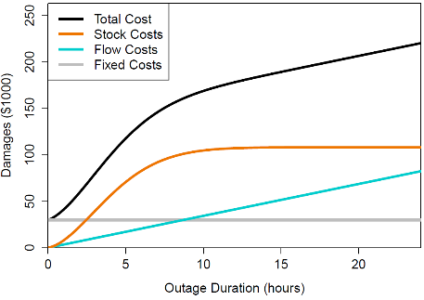
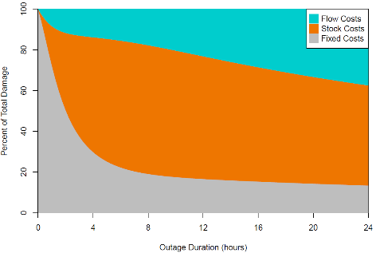
Framework for Integrating Duration-Dependent Value of Lost Load in Energy Decisions
Resilience is typically measured as a static cost in terms of $/kW or $/kWh.
We develop a framework to estimate the customer cost of a power outage, accounting for outage duration.
We then integrate this duration-dependent value into two energy decision models.
The total cost of a power outage varies over time and is made up of stock, flow, and fixed costs.
Ericson, S. & Lisell, L. Energy Syst (2018). https://doi.org/10.1007/s12667-018-0314-8
Notes:
This is the framework we use to value resilience.
Resilience is typically measured as a static cost in terms of $/kW or $/kWh.
However, this does not consider how resilience value changes over time.
We developed a framework to estimate the customer cost of a power outage, accounting for outage duration. If this outage can be avoided, this cost then becomes the value of resilience.
We then integrate this duration-dependent value into two energy decision models.

Slide 30
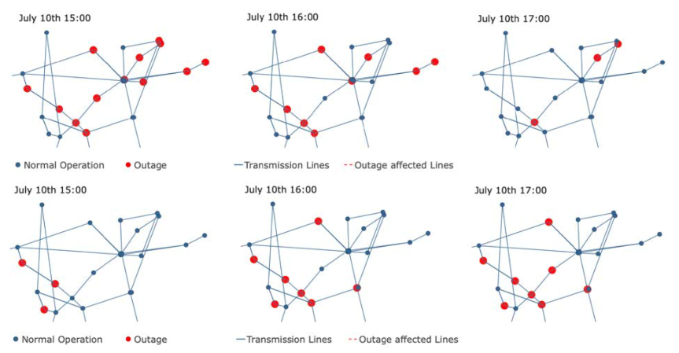
Grid-Scale Production Cost Model Case Study
Research Question: If a grid operator has knowledge of the duration-dependent value of lost load for different types of customers, can the operator strategically allocate limited resources to minimize the total cost of the outage to its customers?
Method: We incorporate a location- and duration-dependent value of lost load in a production cost model framework for least-cost optimization of day-ahead and real-time bulk power system scheduling problems.
Results: Overall system costs and the maximum hours of outage experienced by a bus on a network could be reduced through operational changes that are driven by a more detailed understanding of the duration-dependence of the value of lost load.
A power disruption results in a 15% loss of available generation for 12 hours. A duration-dependent value of lost load results in a modified system dispatch (top row) which reduces outage duration at each bus and overall system costs compared to a static value of lost load (bottom row).
Notes:
The first model is a production cost model that determines the optimum dispatch of bulk power in a utility region. It optimizes day-ahead and real-time scheduling to minimize cost.
We want to understand, if a grid operator has knowledge of the value of lost load for different customers in a region, can the operator strategically allocate limited resources to minimize the total cost of the outage to its customers.
We added an avoided power interruption cost at each node in the system, where nodes are shown by the dots on the right. The avoided cost, or value of resilience, is different at each node, and changes over time.
We modeled a long-duration power disruption where 15% of available generation is lost for 12 hours.
We find that when the model knows about the value of lost load at each node, it modifies the system dispatch to reduce outage duration, and therefore outage cost, at each node. It effectively spreads the outage around more so that no single node incurs too long an outage, and overall outage costs are reduced.

Slide 31
Campus Planning and Operation Case Study
Outage Cost Functions
 | Resilience Value
 | Constant | Duration-dependent
Fixed cost | $0/kW | $16/kW
Flow cost | $13/kW | $8/kW
Stock cost | $0/kW | $0/kW
Research Question: If a site owner understands the duration-dependent magnitude of losses they will incur during an outage, will they make different investment and operational decisions to minimize their lifecycle cost of energy?
Method: We incorporate a duration-dependent value of lost load in REopt to optimize system size and dispatch to minimize lifecycle energy costs for a site, including outage costs.
Results: Knowledge of duration-dependent value of lost load allows a site owner to reduce outage costs and overall lifecycle energy costs using larger PV and storage systems to provide longer duration backup power.
Optimal System Sizing and Cost Results
 | Resilience Value
 | None | Constant | Duration-Dependent
PV size (kW) | 265 | 283 | 321
Battery size (kWh) | 300 | 599 | 692
Outage survival (hours) | 0.24 | 0.66 | 0.87
Total outage cost ($) | $315,319 | $238,788 | $214,853
Outage cost reduction (%) | - | 24% | 32%
Value of resilience ($) | - | $76,531 | $100,466
Notes:
In the second case study we use REopt.
We want to understand, if a site owner will incur losses during an outage, should they make different investment and operational decisions to minimize their lifecycle cost of energy?
We add a time-varying value of lost load to REopt and optimize system size and dispatch to minimize lifecycle energy costs for the site, including outage costs.
We find that when we include a value of lost load, the model recommends larger PV and storage systems to provide longer duration backup power. This allows the site to reduce outage costs and overall lifecycle energy costs.

Slide 32
Future Work
This work was published in the IEEE Systems Journal
Notes:
This work was completed and published in the IEEE systems journal.

Slide 33
The gap between energy decision models and deployment
Increasing Model Transparency
Providing Multiple Options
Integrating Qualitative Values
Modifying Tool Use and Communication
Kate Anderson, Maggie Nevrly, Dr. Adam Warren
Notes:
Now we’ll transition to the last approach. While the previous research focused on adapting the capabilities of the optimization model itself, this research looks beyond that to understand opportunities for adapting how we use the model and how results are communicated to increase deployment.

Slide 34
Overview
Behavioral parameters that could be integrated in techno-economic decision models
This research explores the gap between modeling and deployment through interviews with partners that have received REopt analysis.
We evaluate decision drivers, the tools used to inform decisions, and how tools can be adapted to better inform deployment decisions.
We hypothesize that integrating behavioral parameters into energy decision models may increase the accuracy of energy models in identifying successful projects.
Parameter | Description
Discount rate | Reflects the higher investment risk and lower diversification of individuals
Market heterogeneity | Accounts for varying degrees of savings required to invest
Intangible costs and benefits | Accounts for non-monetary costs of investment
Demand elasticity | Reflects different levels of sensitivity to changes in price
Retrofitting or replacement rate | Accounts for different investment cycles for new capital assets over time
Discount rate with time inconsistency | Represents how individuals value costs and benefits over time
Integration with agent- based and discrete-choice models | Represents how social structures affect and limit individual behavior
Notes:
In our literature review, we find that there has been a fair amount of research on the gap between models and deployment in the residential space, focused on both energy efficiency and solar. There has also been some early work on national scale models.
Researchers at both residential and national scales find there is a need to represent more behavioral factors in models, such as the ones shown on the right.
Our research focuses on the space between the residential and national scale, the commercial sector, because this hasn’t been studied as much in the literature
Through interviews with partners that have received REopt analysis in the past, we try to identify how tools like REopt can be adapted to better inform decisions.
We want to see if these behavioral parameters that are important in residential and national scale energy decision models are also important in this sector for increasing the accuracy of energy models in identifying successful projects

Slide 35
Approach
Research Questions
What are the drivers of and barriers to RE deployment?
How do decision tools impact deployment decisions?
How could a tool or resource be adapted to increase deployment?
Qualitative Data Analysis to develop theory
Summaries & Analysis
Interviews
Transcribing & Memos
Theory
Coding
Notes:
For this study, we are looking at three main research questions.
First, we want to understand what are the divers of and barriers to RE deployment at the commercial scale.
Second, we want to know how decision tools impact these deployment decisions.
And third, we explore how tools or resources can be adapted to increase deployment.
We use qualitative data analysis following a grounded theory approach, as shown in the graphic here. First, we conduct interviews of 23 partners, transcribe the interview recordings, and then code them to identify themes. Based on these themes, we develop theories and then revisit the interviews to see if they apply broadly.

Slide 36
Interview Questions
Project Implementation Decision Drivers
What were the key factors that informed your decision to implement (or not implement) a project?
What was the most important factor?
Information Needs
What information did you need to make a project decision?
Where did you get that information?
What was the most important tool or resource you used?
The Role of Tools in Your Decision
What were the most helpful parts of the tools?
What was missing from the tools or results?
If you were to make a tool, what would it include?
What were your next steps after receiving the tool results?
Describe any differences between what the tool recommended and what was implemented.
Notes:
These are the interview questions we went through with each partner on calls that typically lasted about an hour.
We asked them about the drivers of their project implementation decisions, the information they needed to make their decision, and the role of tools in their decision.

Slide 37
Interviewees
Organization | Type of group | Position
1. Department of Justice | Federal | Energy Management Task Force
2. Drug Enforcement Administration | Federal | Energy Program Manager
3. Department of State | Federal | Design and Engineering
4. General Services Administration | Federal | Energy Division Managers
5. Fish and Wildlife Service | Federal | National Energy Coordinator
6. National Parks Service | Federal | Branch Chief for Sustainable Operations
7. United States Army Corps of Engineers | Federal | Facility Manager, Engineer
8. Army Office of Energy Initiatives | Federal | Opportunity Manager
9. Department of Commerce | Federal | Associate Director of Sustainable Energy and Environmental Programs
10. Federal Bureau of Investigation | Federal | Energy and Environmental Program Manager
11. United States Marine Corps | Federal | Utilities and Energy Manager for Marine Corps at Miramar
12. U.S. Department of Agriculture | Federal | National Facilities, Energy, and Program Manager
13. U.S. Forest Service | Federal | Capital Assets Program Manager for Energy, Water, and Sustainable Buildings
14. National Parks Service #2 | Federal | Energy Program Manager under Sustainable Operations Branch
15. City of Boulder | City | Electrical Engineer
16. Minnesota Department of Transportation | City | Principal Sustainability Planner in the Office of Sustainability and Public Health
17. City of Orlando | City | Director of Sustainability and Resilience, Facilities Project Coordinator
18. Luther College | University | Professor of Religion, Sustainability Office Lead
19. Georgia Tech University | University | Associate Director of the Office of Campus Sustainability
20. Milwaukee Area Technical College | University | Director of Facilities Planning, Sustainability, and Construction
21. Dartmouth College | University | Director of Engineering and Utilities
22. Verizon | Corporation | Principal Planning Engineer at Verizon with background in energy efficiency
23. Equinor | Corporation | R&D Unit Project Manager for Equinor
Notes:
These are the partners we interviewed. The majority are federal, since historically we have worked with many federal agencies, but we also included cities, universities, and corporations to get a more diverse set of organizations in the commercial-scale space.

Slide 38
Coding Approach
Code |  | Definition
Barrier |  | Coded with a factor if it is a reason to not implement the project
Driver |  | Coded with a factor if it is a reason to implement the project
Factors | Economics | Importance of economics to decision making Economic metrics (lifecycle cost [LCC], return on investment [ROI], payback, etc.)
 | Funding | Process of receiving funding and availability or priorities of funding
 | Contracting | Ease or difficulty of obtaining a contract or working on a bid process Alternative financing, vendors, procurement
 | People Support | Clean energy goals and support of management or site
 | Site Resources | Experience or availability of the staff, repeat projects, project champions
 | Loads | Pursues a project because of the demand at the location
 | Grants & Incentives | Incentives provided by utilities, tax benefits, and grants
 | Laws & Policies | Government laws, including state, federal, and local, around clean energy NEPA, interconnection, executive orders, net metering limits, etc.
 | Site Suitability | Site assessment considerations for a new renewable energy project. Structural integrity, generation potential, land and area available, historical site, etc.
 | Land & Building Ownership | Land and building ownership such as leased or owned buildings
 | Resilience | Resilience for project implementation
Notes:
The coding approach we used is shown here
Coding is a process of attaching a code to a piece of text from the interview transcript to categorize it and group segments of text as a specific theme. The codes represent answers to our research questions; this part of the codebook is focusing on the factors that are drivers and barriers of deployment.
After coding, we evaluate trends in codes across all interviews to find themes.

Slide 39
Preliminary Outcomes: Factors Influencing RE Deployment
Notes:
These are some preliminary results, based on coding about half the interviews.
This graph shows the factors coded into drivers and barriers. The height of the bar is the number of times the code was used across all twelve interviews.
A driver is a factor that encourages project implementation. The drivers are shown in green. The most common drivers mentioned include people support, which includes organizational support from leadership and project champions, grants and incentives, and resilience.
Barriers are things that stand in the way of project implementation. The most common barriers mentioned include economics, funding, site resources, laws and policies, and site suitability.
Using this data, we can look at the highest barriers, and evaluate which ones tools may be able to affect.
For example, where site resources like staff expertise and availability are a limiting factor, perhaps a tool can make the process of evaluating a project easier and quicker, and allow site staff to concentrate on just those projects with the highest chance of success.
34 at end of this slide

Slide 40
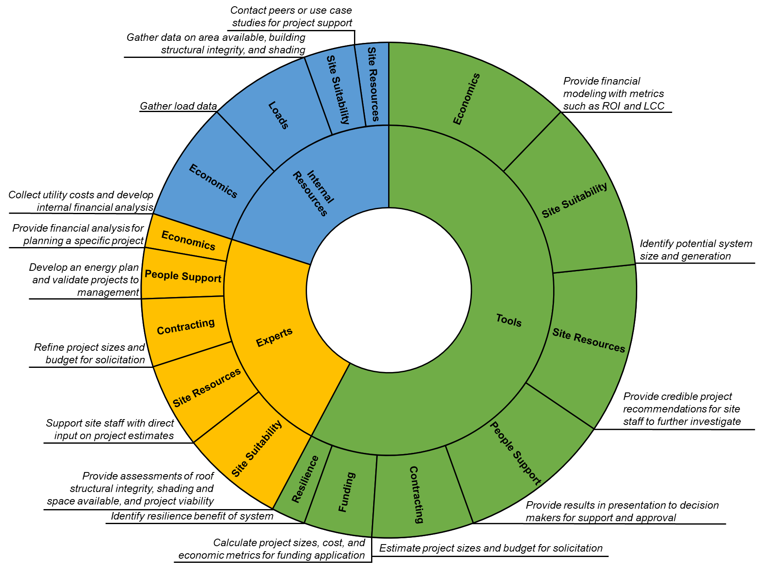
Preliminary Outcomes: Role of Energy Decision Tools in Deployment Decisions
Notes:
This chart highlights the ways that tools address the factors influencing RE deployment. The size of the piece is the number of interviews the code showed up in.
This shows that interviewees highlighted the role of tools in many (7 of the 11 factors) impacting deployment. They do not influence availability of incentives, laws, building ownership, and loads.
However, in most of these areas, tools were not used alone. Even though we were specifically asking about the role of tools, people often mentioned experts and internal resources as key complementary resources. For most categories, tools were paired with either internal resources or experts to more completely address a factor.
For example, on economics, though tools are widely used to conduct financial modeling and calculate economic metrics, internal resources were often required to collect the data needed to feed into the tool (such as utility costs)., and experts were often used to conduct a detailed financial analysis for a specific project.
In general, internal resources were often needed to gather data not automatically available in the tool, and experts were often used to provide assessments of site-specific factors or provide more detailed assessments after the tool.
This seems to suggest that internal resources and experts provide support in areas where tools do not, and the tool alone may not be sufficient in most cases to result in deployment.

Slide 41
Preliminary Outcomes: Improvements to Tools or Resources to Increase RE Deployment
Additional Capabilities
Accurate sizing and production estimates
Accurate cost estimates
Analysis Approach
Complete representation of law, taxes, incentives
Additional technologies
Historic building requirements
Assistance collecting data
Interface changes
Better analysis goal definition
Primary screening to narrow considered sites
Multiple scenarios based on project needs
Additional Resources
Rankings of potential sites based on viability
Iterative cost benefit analysis
Probabilistic modeling
Support from experts
Next step recommendations
Notice of new tools, technology, and resources
Example projects and contacts
Results Communication
Metrics for management context
Context for tool results
References for data used in analysis
Laws and requirements met
Notes:
This chart shows improvements that were suggested by interviewees to the tool.
The left column shows additional tool capabilities they would like to see added. The most common ones mentioned are increasing the accuracy of sizing, production, and cost estimates by accounting for site specific factors like shading, roof structural integrity, historic building limitations, and local costs.
The second column shows requested changes not to tool capabilities, but to how the tool is used. For example, some suggested providing multiple scenarios based on different project needs like emissions reduction, cost reduction, or renewable energy goals. Others suggested conducting a primary screening first, before the analysis, to narrow down the sites considered based on site suitability factors like roof structural integrity and historic building status.
The third column shows recommendations for how the results could be better communicated. Here, people wanted to see results put in context in terms of how far these solutions would get them toward broad sustainability goals, or even other goals like job creation that can be important when selling projects to management.
And finally, the fourth column shows suggestions for additional resources that are completely separate from the tool, but could be provide alongside the analysis results. They often highlighted here that the fact that the results came from experts at NREL carried a lot of weight and lent legitimacy to the results, so merely replacing that with an online tool run by a non-expert was often not seen as an equivalent substitution. Several also suggested that a database of projects and contacts would be really helpful, so they could talk to peers that had implemented similar projects, in similar places, and get their lessons learned.

Slide 42
Future Work
Identify collaborator with expertise in analyzing interview data
Incorporate remaining interviews into analysis
Identify improvements to tools and resources that may increase deployment
Submit paper to Energy Research and Social Science
Notes:
For next steps, we are currently looking to identify a collaborator with expertise in analyzing interview data. We’ve talked with several professors in the business schools at CU, DU, UT Austin, and MTSU in Tennessee and plan to solidify a collaborator in the coming weeks.
We’ll also be incorporating the remaining interviews into the analysis, and evaluating if any new themes emerge, especially any differences across organizations like private and public entities.
Based on the full set of interviews, we’ll identify improvements to tools and resources that may increase deployment.
We’re tentatively planning to submit this paper to Energy Research and Social Science, though we’ll also take into account the recommendations of the collaborator we identify.

Slide 43
Proposed Submissions

Slide 44
Proposed Submissions
Optimizing Design and Dispatch of a Renewable Energy System
Applied Energy, October 2020
Developing Diverse Solutions to Inform Energy Solutions
INFORMS Journal on Applied Analytics, December 2020
Integrating the Value of Electricity Resilience in Energy Planning and Operations Decisions
IEEE Systems Journal, December 2019
The Gap Between Energy Modeling and Deployment
Energy Research and Social Science, April 2021
Notes:
To wrap up, I’d like to summarize the proposed submissions and timeline.

Slide 45
Acknowledgments
National Renewable Energy Laboratory
Dr. Adam Warren, REopt team, Alex Zolan, Josiah Pohl, Maggie Nevrly
Colorado School of Mines
Dr. Alexandra Newman, Dr. Tulay Flamand, Dr. Rob Braun, Seun Ogunmodede, Dr. Jesse Wales, Jusse Hirwa, Chris Hampel
Department of Energy Advanced Manufacturing Office
Bob Gemmer, Patti Garland, Bruce Hedman
Notes:
Finally, I’d like to acknowledge all the help I’ve had from colleagues at NREL including Adam as my co-advisor, the REopt team, and Alex, Josiah, and Maggie who have been a big part of the work presented today.
At Mines, I really appreciate the help of Alexandra as my advisor and Tulay and Rob for serving on my committee. I’ve been working closely with Seun on the REopt paper, and really appreciate the work Jesse, Jusse, and Chris are doing on the CHP addition and decomposition.
And finally, I’d like to acknowledge the DOE AMO sponsors Bob, Patti, and Bruce, that are funding a lot of this work.

Slide 46

Thank you!
Kate Anderson
khanderson@mines.edu
Notes:
That’s all I have for today, and I’m happy to take any questions now.

